Slide 1
FoodQuiz.java
Meredith Hoo
Stephanie Foo
HanSoo Lee
Jenna Ramos
Notes:
HanSoo

Slide 2
Breakdown
Meredith
Question class
Stephanie
Food question research
HanSoo
CSV file
Jenna
Food question research
Searched food images
Together
Constructor
Buttons
ActionListeners
Error-checking
Notes:
HanSoo - Wasn’t sure what to put here exactly because I think we worked on the majority of it together

Slide 3
Initial Idea
Food trivia quiz
Ask series of multiple choice questions
4 answer choices per question
Image for each question
After submission, user clicks “Answer” button
User immediately informed if correct/incorrect with check (✓) or X
User clicks “Next” button
Replace question and answer options with next question
Notes:
Meredith – I know you had the initial idea and you created the paint picture on the next slide, so you can probably describe our initial idea the best ☺

Slide 4
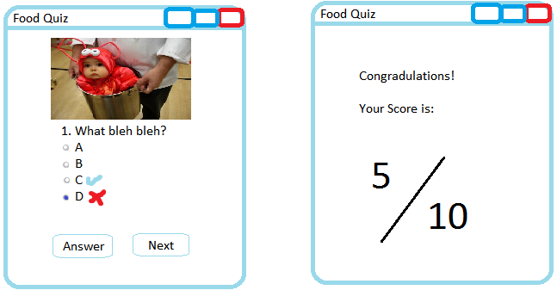
Initial Idea
Notes:
Meredith

Slide 5
Program Problems
Prevent user from selecting 1+ answer
Obtain button that user selected
Replace args of 1st question with args of 2nd question
ActionListener and ActionPerformed
Same button with different Action Listeners?
Notes:
HanSoo

Slide 6
Solutions
ButtonGroup and radio buttons
button.isSelected( )
button.getText( )
button.setText( )
Question class
Args initialized each time Question called with csv args
Replace previous panel contents with new args
Notes:
Stephanie
ButtonGroup class was used, which helped with selection of only 1 button
Radio button = type of button
3 methods mentioned helped with obtaining button information from button that user selected
Question class had 7 fields for each object of the Question type
Args from Question class fed into labels and panels to be presented on GUI

Slide 7
Solutions
5 buttons, 1 Action Listener each
if statement in actionPerformed() to check button text
if button text = “Answer”
check if answer is correct
set button text to “Next”
else if button text = “Next”
replace args
remove button and add new button
Notes:
Stephanie
Ran into problems with using same button for all 5 questions
Tried resetting text between “Answer” and “Next”, but encountered more problems
Easier to add / remove button for each question asked

Slide 8
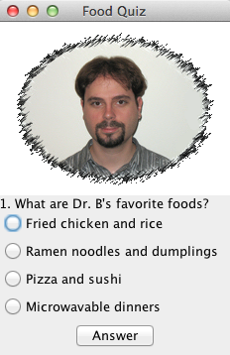
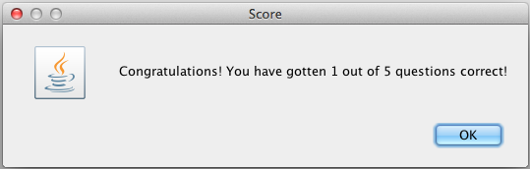
Fun Features
5 multiple choice questions asked
Plus a question about Dr. B.’s favorite food!
Image appears with each question
Score message window at the end to inform user
Notes:
Jenna

Slide 9
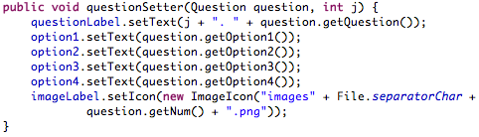
questionSetter( )
Called after each “Next” button pushed
Resets questionLabel and ButtonGroup options for each question
Notes:
Jenna – just explain what each line of code is doing and use the bullets to explain why this was a key method

Slide 10
Resources
For methods and classes:
Java API Platform
http://docs.oracle.com/javase/6/docs/api/
For code to reference:
Stack Overflow
http://stackoverflow.com/
Previous code / programming labs
Notes:
Jenna

